Slide 1
MINECOFIN Quarterly Macro-Fiscal Model (QMFM)
Quarterly Macro-Fiscal Outlook (QMFO)
Summary Outlook Presentation 2023-26
January 3, 2024

Slide 2
Outline/contents
Rationale of outlook & underlying model
Recent macroeconomic developments
Macroeconomic forecast assumptions
Summary current cyclical position & policy stance & ExtEnv
Domestic environment assumptions
External environment assumptions
Macroeconomic forecast/outlook
Summary of macroeconomic forecast/outlook (2023Q3-2027Q4)
Output and cyclical position
Fiscal deficit and components
Inflation-headline CPI
Monetary policy –interest and exchange rates
Data issues and requests & suggestions
Alternative scenarios
QMFM: main relationships and transmission mechanisms

Slide 3
I. Rationale of outlook & underlying model
provide forecast for key macro variables (i.e.,. output, inflation, final demand…...) for 16 quarters ahead as influenced by fiscal, monetary, and exchange rate policies, incl. in response to shocks and new developments
simulate alternative policy scenarios suggest policy implications & recommendations.
provide input for the validated macro-fiscal projections underpinning the (medium-term) Budgets and IMF-supported programs, complementing the intMF and other macro projection tools
facilitate policy coordination between MINECOFIN and NBR; IMF mission preparation; policy debate
tool/model: Quarterly Macro Fiscal Model, a so-called “gap” model:
emphasis on fiscal variables & deficit components (revenue, govt spending & structural, discretionary, cyclical components)
tracing key macro variables in deviation from trends, potential levels, or targets:
after shocks and policy responses, variables return to their LT trends subject to persistence/lags (outside model)
potential growth, neutral interest rate, equilibrium real exchange rate change, sustainable deficit, target inflation rate….

Slide 4
1I. Recent macroeconomic developments (2017-23Q2) Real GDP/Output
Output gap (%) drivers
Covid years (2020-21)
consumption and investment accounted for most of the GDP drop and output gap
fall in imports and expansionary government demand helped mitigate the downpull on GDP;
Immediate post-Covid (2021-22)
consumption and investment contributed most to the recovery
supported by continued government demand, while exports remained sluggish
Ukraine-war (2022-23)
post-Covid recovery slowed down due to jumps in international oil and food prices, causing high inflation and drop in real consumption and other demand
fiscal consolidation started (though in part thwarted by floods) and lowered the expansionary effect of govt demand
Real GDP, YoY %
trend growth (2000-19) averaged 7.5%
in COVID 2020, GDP dropped 3.4% and was 12% below potential (had trend growth continued) due to drops in external and domestic demand and supply constraints
expansionary fiscal policy mitigated Covid output drop and helped subsequent recovery
global instability, esp. Ukraine-war, slowed down the recovery from 2022Q1 onward
despite strong bounce back in 2021, GDP estimated 6% below potential in late 2023

Slide 5
1I. Recent macroeconomic developments Fiscal policies and deficit components (2015/16-2022/23)
Fiscal deficit (before grants, % GDP, GFS-1986) and Govt demand (%GDP)
[some fiscal consolidation pre-Covid—slightly lowered deficits averaging 10% of GDP in FY2015/16—2018/19, mainly through lower spending on G&S (“discretionary”)]
expansionary fiscal stance under Covid—increased deficits averaging 14% of GDP in FY2019/20—2021/22, mainly Covid-related spending on G&S (incl. school construction) and transfers/subsidies, mostly “discretionary” spending and deficit, only small “cyclical” deficit
start of fiscal consolidation post-Covid—deficit declined to 12% of GDP in FY2022/23, with spending on G&S falling by 3% points of GDP (despite flood-related spending)
fiscal stance entailed sharp drop in real govt demand for G&S, further exacerbated by surging inflation from early 2022

Slide 6
Inflation—headline CPI
Headline CPI—drivers (left chart)
Covid years (2020-21)
above target during 2020 induced by higher COVID-related food and core prices (imports)
Immediate post-Covid (2021-22)
lower, driven by still sluggish economy, good agricultural harvests, and less expensive imports
Ukraine-war (2022-23)
sharply increasing food prices: driven by negative agricultural production gap and other supply shocks
sharply increasing world energy and commodity prices
higher core prices: expectations, import prices (in/direct), supply-side shocks (pricing behavior not captured in model)
CPI , YoY %
highly volatile, mostly driven by factors unrelated to business cycle (e.g., agric. & weather shocks, energy), output gap has only modest influence
food & energy prices contribute most to volatility, directly and indirectly
each inflation component has its own drivers (charts)
recent surge in inflation: weak harvests, soaring world food and energy prices, other domestic supply-side shocks….
deceleration observed in core and food inflation, fall in energy from 2023Q1

Slide 7
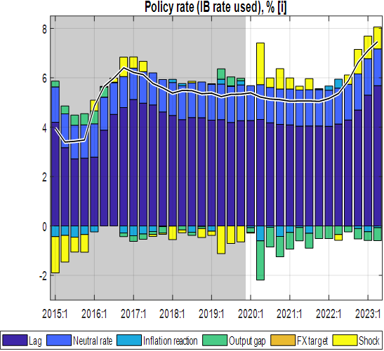
Monetary policies (i): market interest rates (2019-23)
Real interest rates, %
rose during Covid 2020-21, when inflation was subdued and the IB was lowered only once, by 0.5% 2020, in response to the Covid downturn
since mid-2021, below trends; IB even negative in most of 2022
from mid-2022, went back up sharply as nominal interest rates were moved up and inflation declined
real lending rates followed IB, and after a low point of 7% in mid-2022 reached some 12% by 2023Q3
IB (effective ‘policy’ rate)
since 2017 and esp. through 2020-21, IB was on a downward path and below its trend (‘neutral’) level of some 6.5-7%
since early 2022 to 2023, CBR raised stepwise from 4.5% to 7.5% in response to inflation—IB rate followed
IB rate almost back to neutral rate by mid-2023
.

Slide 8
Monetary policies (ii): exchange rates (2019-23)
Real exchange rate (RER), QoQ %
from mid-2020, the faster nominal depreciation (+) and subdued inflation more than reversed the earlier RER appreciation (-)
however, from late 2021 till 2022Q3, modest nominal depreciation and surge in core inflation lowered RER, to well below trend, more than offsetting the earlier increase
acceleration of nominal depreciation since late 2022 resulted in a sharp increase in the rate of RER depreciation
nominal Exchange Rate (ER), QoQ %
since late 2022, the ER depreciation rate has moved up sharply in line with the target ER depreciation rate
driven largely by high domestic inflation relative to trading partners, in addition to other factors (interest-rate differentials, trend RER depreciation rate,..)

Slide 9
III. Macroeconomic Forecast Assumptions Summary current cyclical position & policy stance & ExtEnv
GDP/Output, YoY %
estimated slower growth of 6% in 2023 (due to Ukraine war shocks, inflation surge, weak agricultural performance)
estimated output gap (below estimated potential output) of -7% of GDP by end-2023
Inflation—headline CPI, QoQ %
expected to end at just above 10% in 2023—downward path from its peak of 25.6% in 2022Q2 driven by:
easing food price increases, falling energy prices
fading core-price shocks and tighter macroeconomic policies.
Fiscal policy stance—deficit excl. grants, govt demand, %GDP
fiscal consolidation of 2022/23 reinforced with next two Budgets: deficit reductions of 1% of GDP in FY2023/24, further 1% of GDP in FY2024/25
shift from expansionary to contractionary fiscal stance btn. 2020-22 and 2023-25, mostly borne by lower govt demand for G&S
fiscal stance switches from +2% to -2% of GDP, with an average total effect on output of +/-1.7% of GDP
Monetary—interest & exchange rate policy stance, QoQ %
modestly tight monetary (policy amidst decelerating domestic inflation)—almost back to the neutral interest rate
real interest rate (RIR-IB) almost positive—still below its trend of 3%—helped to stem private demand in 2023 (though consumption and investment responded little to changes)
2023 acceleration of nominal ER depreciation largely offset Rwanda’s recent high inflation differential, reversing the overvaluation since late 2021
this has raised real exchange rate back to its trend by 2023Q3—positively affecting net exports
External environment (WEO projected)
overall more favourable external environment thanks to recovering foreign demand, easing world food and oil prices & trading partner's CPI

Slide 10
External environment assumptions (IMF WEO-GAS & GEE)
overall outlook improving after the Covid-Ukraine crises, but with downside risks. World economy slowing down due to tight monetary policies in response to inflation
foreign demand—trading partners’ GDP, YoY %
recovered post covid but slowing down as interest rates raised in response to inflation since mid-2022
recovery in relative to Covid-years, at 3% p.y., well above trend
positively affected domestic demand
below trend—negatively affect domestic demand from 2024 until 2025
foreign real interest rates—US RIR, %
past decade to 2027 –projected to rise from negative around -1% to +1%
implies a one-for-one transmission to Rwanda’s sovereign borrowing rates
foreign inflation—trading partners’ CPI inflation, in US$ (YoY %)
subdued at 1.4% p.y. during 2016-22 before flaring up in 2023
2024-onward projected to return to its trend level of 2%.
food & energy prices slowing down (below trend) post 2024

Slide 11
Domestic environment assumptions
Current fiscal, monetary, and exchange rate policies (in part “tuned”—exogenously imposed on forecast):
post-Covid consolidation and winding down of crisis-related spending since 2021/22 reinforced in 2023/24 Budget,
a further reduction in the deficit before grants to 10.8% of GDP in 2023/24, and to 9.7 % by 2025/26
fiscal deficit (excl. grants) assumed return to 8% level for beyond PCI program (2025/26-2026/27)
maintenance of current 8% level of policy interest rate (IB) for 2023Q4
somewhat faster exchange rate depreciation in 2023 (than 2022), based on statements and the IMF PCI program targets (i.e., Q4 is NBR = IMF program forecast --15% eopER depr in 2023, quarterlized and applied to Q3 p.a.)
expected return to normal of agricultural harvests and domestic food prices and rep. shocks during 2023Q4-24Q1
note: 2023/24 and 2024/25 Budget deficits and spending on G&S have been tuned based on the semester breakdown of annual figures (because the projected quarterly breakdown is not available), hence quarters are the same within the semester
Notes:
The QMFM sustainable debt-creating deficit is 5% of GDP under assumptions of: debt/GDP target of 55% (45% in NPV terms, o/w 10% domestic and 35% foreign debt, grant element 22%), real GDP growth 7.5% p.y., trading partner inflation 2% p.y., and trend RER depreciation rate 0%. The structural deficit consists of revenue 21%, government consumption 13%,government investment 11%, and other spending 5% of GDP.

Slide 12
IV. Macroeconomic forecast/outlook Summary of macroeconomic forecast/outlook (2023Q3-2027Q4)
temporary above-trend growth for two years from mid-2024 is mostly driven by private consumption and return to normal of government demand
combination of modestly tight fiscal and monetary policies and still low RER in 2023-early 2024 should help contain domestic demand and lower inflation.
as inflation abates to close to the 5% target from earlier 2024Q2.
temporarily lower interest rates (IB) & RIR and higher RER should raise GDP growth temporarily above its trend in 2024-25, and back to its trend afterwards towards 2027.
fiscal policies (2023/24-2025/26 & onward)
fiscal consolidation—negative discretional spending (combination of lower Govt. demand and a negative effect on private demand)
shall induce a negative effect on output/GDP by some 1.2%
2025/26 onward
fiscal consolidation estimated to die out—positive discretional spending (gradually positive Govt. demand and fiscal impulse)
should positively affect output/GDP

Slide 13
Forecast—Output and cyclical position (GDP growth)
growth of the final demand & components of GDP Table 6,
GDP is estimated to be 7% below potential at end-2023,
due to both incomplete recovery from Covid and sluggish growth in 2022-23.
Output growth is expected to be a bit faster than trend in 2024-26 driven by:
a full recovery of consumption and government demand.
2022-23 sluggish GDP growth, driven by:
--consumption recovery from Covid interrupted by
--Ukraine-war, inflation surge and restrictive policy response
---post-Covid fiscal consolidation with negative fiscal effect & impulse
2024-26 growth above trend, driven by:
---less restrictive fiscal policies as deficit gradually back to (higher) sustainable level and govt demand for G&S back to normal
--exports helped by high RER
from 2027, back to trend growth of 7.5%
---there is no indication that Covid has permanently reduced potential output and its growth

Slide 14
Forecast—cyclical total demand driving GDP
--output gap closing in as output (level) approaching its trend by 2026.
--output gap moves around zero trend when its level catches trend
Output-below-potential (negative gap) and its components
Negative output gap declines gradually:
--lessening down pull from consumption which goes back to normal
--large initial down pull from reduction in real government spending gradually disappearing from mid-2024
--exports helped by increasing (depreciated) REER

Slide 15
Private consumption and cyclical position
Consumption back to trend, drivers:
--persistence, lagged effect
--expectations
--income, proxied by real GDP
--negative fiscal impulse
Consumption gap:
--estimated to recover from recent low levels but remains restrained in 2024
---due to low GDP growth and negative fiscal impulse in 2023-24.
---returns to trend growth late in 2026 when fiscal and monetary policy becomes again less restrictive.
Notes:
We tuned GDP down in 2023Q1 (nowcast), and tuned cons down too (shock)

Slide 16
Private investment, exports & imports and cyclical position
private investment
Main drivers:
-- persistence (lag)
--expectations
--real interest rate (RIR) effect is very small
--RER has no effect (zero wight in monetary conditions index)
--small income, effect (proxied by real GDP)
--fiscal impulse has very small effect
exports
Main drivers:
--persistence (lag)
--expectations
--foreign demand (mainly relevant for tourism, albeit with small coefficient)
--down pull from RER overvaluation disappears
imports demand (for goods and services)
Main drivers:
--final demand components, esp. consumption, govt demand, investment
--RER effect reverses to negative as real depreciation (lower overvaluation) reduces imports
Notes:
We tuned GDP down in 2023Q1 (nowcast), and tuned cons down too (shock)

Slide 17
Fiscal stance (i): govt demand for G&S affects output directly
Fiscal policies (“fiscal stance”) affect output in the short-run via several channels captured in the model:
--Govt. demand, % GDP level is below its structural trend 2023Q2-2027—
--Implies a negative gap and a fiscal consolidation post 2023
Government demand for G&S (direct) (+ 23% of GDP):
---current fiscal program envisages a reduction in the deficit (consolidation) to 10.8% of GDP in 2023/24 and to 9.7% in 2024/25,
---well below that in Covid and immediate post-Covid years (averaging 14% of GDP in 2019/20-2021/22).
--consolidation achieved mainly via the ending of discretionary, crisis-related spending and cuts in investment,
---translate in a significant reduction in real government demand for G&S, lowering aggregate demand and helping contain inflation.
---large negative effect on demand—consumption & imports is estimated to last till early 2026
Notes:
See Output gap and Fiscal Impulse in last Chart

Slide 18
Fiscal stance (ii): fiscal impulse affects output via private demand
fiscal stance total effect on output (direct & indirect):
combination of lower government demand and a negative fiscal impulse
Estimated to have an important (desirable) negative effect on output during 2023/24-2025/26
average negative discretionary deficit of 1½% of GDP
estimated per se to lower real GDP by some 1.2%, mainly from lower government for G&S (0.66) and the remainder (0.5) from lower private demand.
“fiscal impulse”—deficit affecting private demand and hence output indirectly)
---positive on average in 2020-22,
---turns negative from late 2022 onward
---remains so for several years before fading out by 2027
Notes:
In more aggregate models, “fiscal impulse” comprises both direct effect of govt spending on G&S and the indirect effect via private consumption and investment (affected by transfers/subsidies and reduced effective revenue collection)

Slide 19
Fiscal stance: deficit and its components (revenue, spending)
Budget deficit (excl. grants), % GDP (revenue & demand/spending)
--lower deficit for 2023/24-2024/25, (10.8% & 9.7% of GDP in 2025/26, down from 12% for 2022/23 to inline fiscal consolidation in the IMF PCI program)
---show a sharp reduction in deficit (before grants) and spending on G&S, as discretionary spending reduces.
---post tuned PCI-program (2025/26 onward)
---fiscal deficit to converge to a sustainable deficit (before grants) of 8% and
--constituent parts (revenue, spending,…) are forecast to gradually move to their structural levels
Budget deficit, % GDP (structural, discretional and cyclical)
---structural deficit evolving 8% average sustainable level
--volatility in deficit mostly dominated by discretional spending (Govt. demand for G&S and other expenditure (i.e, transfers, subsidies and net lending)
---reduction in deficit (consolidation) driven by a fall in discretional spending for post 2023
Notes:
Optional illustration of fiscal impulse in relation to output/gap

Slide 20
Forecast—Inflation (headline CPI & components)
headline—CPI, (YoY %)
---for late 2023 – early 2024 (having peaked in 2022Q2) forecasted to continue declining but with a modest flare-up
---from 2024Q2, should decline below 5%
--modest drop in world food and oil prices,
--improved domestic food supply & earlier shocks fading
---largest contribution comes from the moderate food price increases, even with a short period of falling prices.
core-CPI, (QoQ %)
---gradual drop driven by inflationary expectations, small upward direct effects of import prices and REER
--small downward effect of persisting post-Covid negative output gap and gradual subsiding of shocks
---falls in mid-2025 slightly below its target of 4.5%
--down-pull from remaining negative output gap,
---somewhat overshoots in 2026-27 (to.5.5%) as a small positive output gap emerges.
food-CPI, (QoQ %)
---rapid drop (from a peak in 2022Q4) is mainly driven by declining negative agricultural output gaps (which in part drove prices up from late 2021 to late 2023),
---direct effect of imported food prices is upward (due to ER depreciation),
---indirect effect of the food RER gap is downward falls in mid-2025 slightly below its target of 4.5%
---shocks, already small in 2024, are forecast to subside in the near term
energy-CPI, (QoQ %)
---rapid drop (from a peak in 2022Q4) is mainly driven by direct effect of imported energy prices which are projected to fall throughout 2023-27
---exchange rate depreciation exerts some upward pressure, but offset by drop in foreign energy prices
---shocks projected to disappear since 2024Q1(typically large especially in 2022-23, reflecting the Oct 2023 pump price increase)

Slide 21
Forecast—Policy interest rate (interbank rate, IB)
IB rate, %
--assumed unchanged for Q4 2023, assuming NBR would keep its CBR unchanged from August 2023
--about 0.5% points above the CBR (equal to repo rate; CBR not shown separately)
--IB trend/neutral level (7.5%),
--determined by trend foreign RIR (0-0.5%), country risk premium (2%), and core inflation target (4.5%)
drivers of policy rule in 2024:
--expected inflation deviation from target (-)
--negative output gap (-)
--pull from neutral interest rate (7%) (+)
--gradual interest rate changes, (lagged effect)
IB rate, %
--gradually lowered from its peak of close to 8% in August 2023 to around 6½% in late 2024
--as inflation drops below the 5% target and a negative output gap remains.
from mid-2025, converges to its trend/neutral level (7.5%
RIR—IB rate, %
---significant drop into negative territory since early 2021
--high inflation and lagged interest policy response,
---forecast to pick up on late 2022 level, as nominal interest rates rise and inflation eases,
---forecast to remain below its trend level of 2-2.5% and even slightly drop in mid-2025
--as inflation flares up temporarily due to demand pressure
real lending rate, %
---4Qos forward average RIR(IB) + lending premium (+ 9% points above the IB rate)
---movement in the RIR (as affected by NBR policies) is transmitted to the real lending rate for private demand
---above trend during Covid and much below trend, even negative, when inflation surged in 2022-23
---forecast to rise to close to its trend level in 2023, with a depressing (increasingly less positive) effect on private demand

Slide 22
Forecast—Nominal and Real Exchange Rate (ER & RER)
nominal ER, QoQ%
---forecast reflects NBR’s flexible exchange rate policy and its hybrid rule in practice
--steering the ER to the target ER such that the RER gradually matches the target depreciation rate
---continue its recent fast depreciation than target (annualized 15% for most of 2023)
---correcting for the recent overvaluation due to high domestic inflation.
---then returns gradually to the target ER depreciation rate
RER, QoQ%
---slowdown in the pace of depreciation (from its high in 2023) to return gradually to its (zero) trend level
---upward correction in 2022-23 estimated to favourably affect net exports and demand (reversing a sharp RER decline during 2021-22)
---rise to its trend level (with some overshooting in 2024) and to affect demand favourably in 2023-24.
---after overvalued RER had a downward effect on net exports demand in 2021 when the economy emerged from Covid

Slide 23
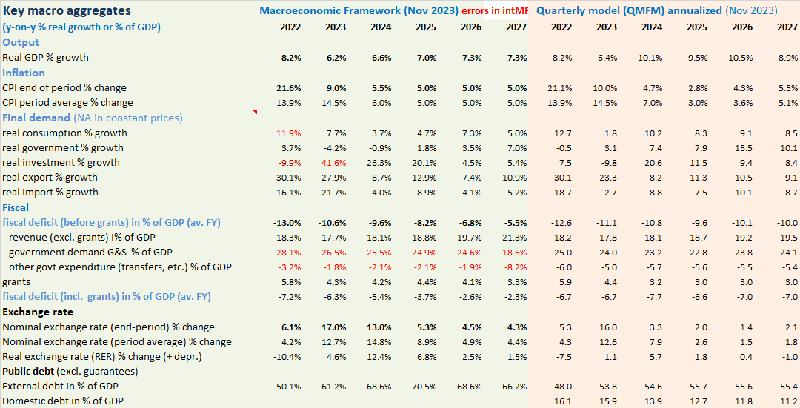
V. Comparison with Integrated Macro Framework (intMF) (to update)
Illustrative comparison with Oct. 2023 intMF proj. (PCI-RSF)
annualized QMFM result has—compared to MF:
lower volatility in final demand components, especially for consumption, investment, and imports (MF anomalies…)
higher average CPI inflation in 2023, more accurate as it traces inflation by quarter
lower ER depreciation from 2024, as it forecast zero RER depreciation in MT, the MF has real depreciations each year in 2024-26
higher fiscal deficits return to sustainable level, whereas PCI reduces deficit much below
correctly reproduced historic data.

Slide 24
VI. Data issues and requests & suggestions
data inputs
IntMF –debt stock, fiscal (deficit, Govt demand (g&s and investiment)
NA–GDP and Govt. consumption
BNR-monetary survey –interest and exchange rates
WEOGAS & GEE—foreign/trading patterners projections (i.e., output, interest rates, prices)
data issues and requests
Model results (proj.) on key macro indicators compared/cross-checked with intMF for consistency
so imperative to get full consistent intMF earlier ahead of model forecast round (i.e., fiscal (Qo treasury plan for 2023/24 is not available) and Debt stock –actual or provisional data)
inconsistency—diff. definition between NA & budget Govt consumption (NA overestimation of Govt cons by considering part of Govt investment as consumption)
pending NISR corrections, intMF (real & fiscal) should reflect/follow QMFM treatment (i.e., 80% govt invBudget and rest added on consNA)
NBR-FPAS inflation & ER ann. outlook for model ‘’tuning judgment’’
Notes:
MINECOFIN can have a different assessment of path and impact of monetary and ER policies than NBR, just as NBR can have a different assessment of path and impact of fiscal policies.

Slide 25
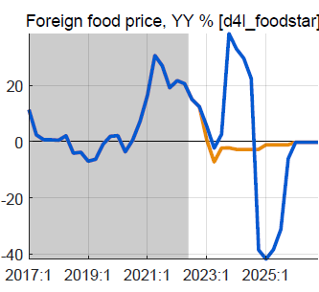
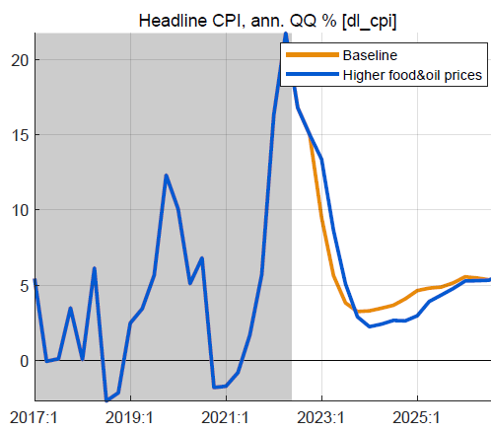
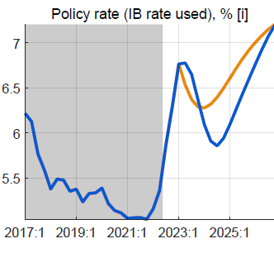
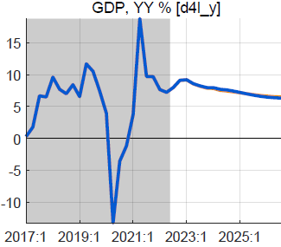
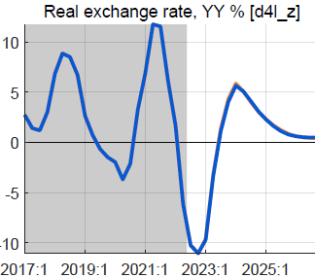
VII. Alternative scenario: higher foreign food/oil prices (2023-24)
Higher-than-WEO foreign food and oil prices in 2023-24
foreign food and oil prices on average 25% higher than BL
with peak around end-2023, return to WEO levels from 2025
no change in fiscal policy
Results in higher headline CPI, little or no effect on output
headline CPI temporarily higher, reflecting food/oil import shares
small response policy rate, reversed fast as expected inflation drops
small positive effect on demand of lower RIR
mostly offset by negative effect of slightly more appreciated RER
overall effect on GDP is very small, less than 0.2%

Slide 26
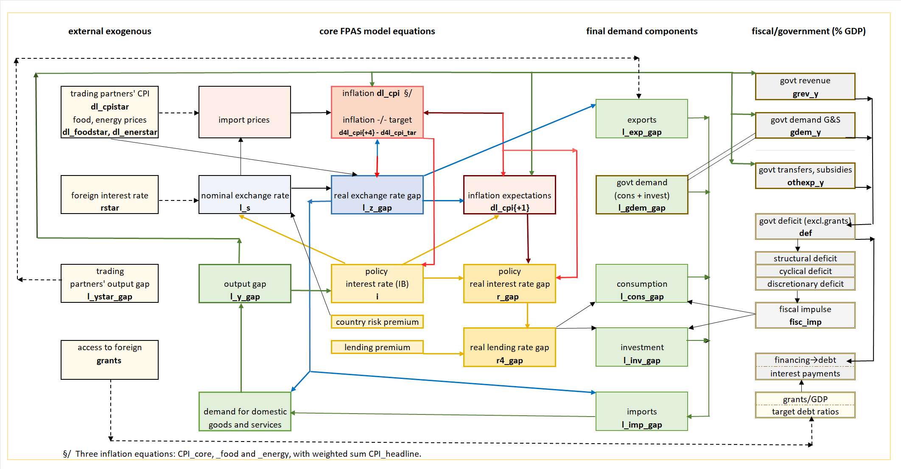
VIII. QMFM: main relationships and transmission mechanisms

Slide 27
THANK YOU

